Slide 2















Thank you to our sponsors!

Slide 3







Who is Chad Green
chadgreen@chadgreen.com
TaleLearnCode
ChadGreen.com
ChadGreen & TaleLearnCode
ChadwickEGreen

Slide 4
Public Service
Announcement

Slide 5

Public Service
Announcement

Slide 6






Listen to your body

Slide 7


Listen to your body

Slide 8
How did I get started with NoSQL databases?

Slide 9
What are Relational Databases

Slide 10

Relational Model
First-order predicate logic
Described by Edgar Codd in 1969
Data represented in terms of tuples
Purpose is to provide declarative method for specifying data and queries
Notes:
Approach to managing data using a structure and language consistent with first-order predicate logic
First described by Edgard F. Codd in 1969
Where all data is represented in terms of tuples, grouped into relations
Finite ordered list (sequence) of elements
Purpose of relational model is to provide a declarative method for specifying data and queries: users directly state what information the database contains and what information they want from it, and let the database management system software take care of describing data structures for storing the data and retrieval products for answering queries

Slide 11
Codd’s 12 Rules
0: Foundation Rule
1: Information Rule
2: Guaranteed Access
3: Systematic treatment of NULL values
4: Active Online Catalog
5: Comprehensive data sublanguage
6: View Updating
7: Possible for high-level insert, update, and delete
8: Physical data independence
9: Logic data independence
10: Integrity Independence
11: Distribution Independence
12: Nonsubversion Rule
Notes:
0: Foundation Rule — For any system that is advertised as, or claim to be, a relational data base management system, that system must be able to manage databases entirely through its relational capabilities
1: Information Rule — The data stored in a database, may it be user data or metadata, must be a value of some table cell. Everything in a database must be stored in a table format.
2: Guaranteed Access — Each and every datum (atomic value) in a relational database is guaranteed to be logically accessible by restoring to a combination of table name, primary key value, and column name.
3; Systematic treatment of NULL values — The NULL values in a database must be given a systematic and uniform treatment. This is a very important rule because a NULL can be interpreted as one the following − data is missing, data is not known, or data is not applicable.
4: Active Online Catalog — The structure description of the entire database must be stored in an online catalog, known as data dictionary, which can be accessed by authorized users. Users can use the same query language to access the catalog which they use to access the database itself.
5: Comprehensive data sublanguage — A database can only be accessed using a language having linear syntax that supports data definition, data manipulation, and transaction management operations. This language can be used directly or by means of some application. If the database allows access to data without any help of this language, then it is considered as a violation.
6: View Updating — All the views of a database, which can theoretically be updated, must also be updatable by the system.
7: Possible for high-level insert, update, and delete — A database must support high-level insertion, update, and deletion. This must not be limited to a single row, that is, it must also support union, intersection and minus operations to yield sets of data records.
8: Physical data independence — The data stored in a database must be independent of the applications that access the database. Any change in the physical structure of a database must not have any impact on how the data is being accessed by external applications.
9: Logic data independence — The logical data in a database must be independent of its user’s view (application). Any change in logical data must not affect the applications using it. For example, if two tables are merged or one is split into two different tables, there should be no impact or change on the user application. This is one of the most difficult rule to apply.
10: Integrity Independence — A database must be independent of the application that uses it. All its integrity constraints can be independently modified without the need of any change in the application. This rule makes a database independent of the front-end application and its interface.
11: Distribution Independence — The end-user must not be able to see that the data is distributed over various locations. Users should always get the impression that the data is located at one site only. This rule has been regarded as the foundation of distributed database systems.
12: Nonsubversion Rule — If a system has an interface that provides access to low-level records, then the interface must not be able to subvert the system and bypass security and integrity constraints.

Slide 12
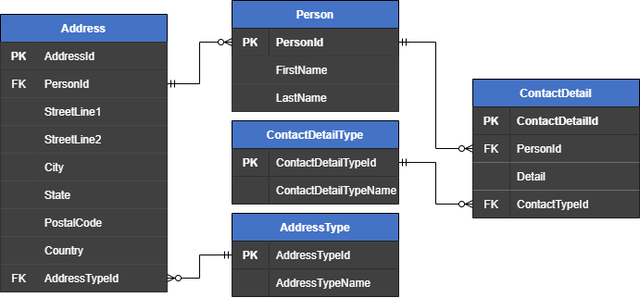
Typical Relational Model

Slide 13
True star of Relational Databases
SQL
Structured Query Language
SEQUEL
Notes:
Donald Chamberlin and Raymond Boyce with IBM started working on SEQUEL which was designed to manipulate and retrieve data stored in IBM’s System R (regarded as the first relational database system)
SEQUEL – Structured English Query Language
Introduced the concept of accessing many records with one single command and eliminated the need to specify how to reach a record with or without an index
First commercially available SQL was released in 1979 by Relational Software who had aspirations of selling it to the US Navy, CIA, and other government agencies; Relational ➔ Oracle
Officially adopted as a standard in 1986 and has had 11 versions (last version was 2019 – multidimensional array support)
SQL – San Carlos Airport

Slide 14

True star of Relational Databases
SQL
Structured Query Language
By Saufhn - Own work, CC BY-SA 4.0, https://commons.wikimedia.org/w/index.php?curid=87255205
Notes:
SQL – San Carlos Airport

Slide 15






Big Names in Relational Databases
Notes:
6 of top 10 according to db-engines.com
Oracle
MySQL
Microsoft SQL Server
PostgreSQL
MongoDB
Redis
IBM Db2
Elasticsearch
SQLite
Cassandra

Slide 16
What are NoSQL Databases

Slide 17
What are NoSQL Databases
Modeled in means other than tabular relations
Existed since late 1960s
Increasingly used in big data and real-time web applications
Notes:
Provide a mechanism for storage and retrieval of data that is modeled in means other than the tabular relations used in relational databases.
Such databases have existed since the late 1960s, but the name “NoSQL” in the early 2000’s, triggered by the needs of Web 2.0 companies
NoSQL databases are increasingly used in big data and real-time applications

Slide 18
NoSQL Motivations
Simplicity of Design
Simpler Horizontal Scaling
Finer Control over Availability
Limiting Object-Relational Impedance
Notes:
Simplicity of design
Simpler “horizontal” scaling to clusters of machines (scale out vs scale up)
Finer control over availability
Limiting the object-relational impedance mismatch
The data structures used by NoSQL databases are different from those typically used in relational databases, potentially making some operations faster.
Viewed as “more flexible”

Slide 19
Availability over Consistency
Relational
ACID Transactions
NoSQL
Eventual Consistency
Notes:
ACID (atomicity, consistency, isolation, durability) : intended to guarantee data validity despite errors, power failures, and other mishaps. For example, a transfer of funds from one bank account to another, even involving multiple changes such as debiting one account and crediting another can be completed in one transaction.
Eventual consistency – database changes are propagated to all nodes “eventually”; so queries for data might not return updated data immediately or might result in reading data that is not accurate (stale reads)

Slide 20
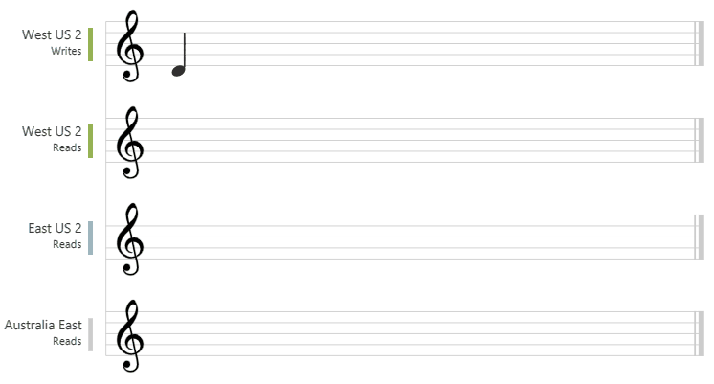
Eventual Consistency
Notes:
This graphic illustrates the eventual consistency with music notes

Slide 21
What’s in a Name
NoSQL

Slide 22
What’s in a Name
NoSQL

Slide 23
What’s in a Name
Not only SQL
Non-SQL
Non-Relational
NoSQL

Slide 24
What’s in a Name
Not only SQL
Non-SQL
Non-Relational
NoSQL

Slide 25
What’s in a Name
No-Schema
Not only SQL
Non-SQL
Non-Relational
NoSQL
Notes:
Next slide – Along with different names, there are a lot of different types of NoSQL databases

Slide 26






Many types of NoSQL databases
Document
Notes:
Document databases store all information for a given object in a single instance in the database instead of multiple objects like in a relational database

Slide 27
Typical Relational Model

Slide 28
Same but in a document database
{
"id": "1",
"firstName": "Thomas",
"lastName": "Andersen",
"addresses": [
{
"city": "Seattle",
"state": "WA",
"type": {
"name": "Primary"
}
}
],
"contactDetails": [
{
"detail": "First Detail",
"type": {
"name": "A detail type"
}
}
]
}

Slide 29
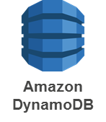


Many types of NoSQL databases
Key-Value
Notes:
Data storage paradigm designed for storing, retrieving, and managing associative arrays

Slide 30




Many types of NoSQL databases
Wide Column
Notes:
Uses tables, rows, and columns, but unlike a relational database, the names and format of the columns can vary from row to row in the same table
Can be interpreted as a two-dimensional key-value store

Slide 31
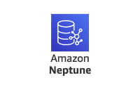


Many types of NoSQL databases
Graph
Notes:
Graph databases are designed for data whose relations are well represented as a graph consisting of elements connected by a finite number of relations.
Social media

Slide 32
Graph Databases

Slide 33
Many types of NoSQL databases
Document
Key-Value
Wide Column
Graph
Object
Tabular
Tuple Store
Triple Store
Notes:
Object Databases – Information is represented in the form of objects as used in object-oriented programming.
Tabular Databases – Database that is structured in a tabular form; arranges data elements in vertical columns and horizontal rows
Tuple Store – Based on tuple mathematics
Triple Store – Purpose-built database for storage and retrieval of triples through semantic queries. A triple is a data entity composed of subject-predicate-object like “Bob is 35” or “Bob knows Fred”

Slide 34
Picking a Data Store

Slide 35
Data Model Comparison
Data Model | Performance | Scalability | Flexibility | Complexity | Functionality
Key-Value Store | High | High | High | None | Variable (None)
Column Store | High | High | Moderate | Low | Minimal
Document Store | High | Variable (High) | High | Low | Variable (Low)
Graph | Variable | Variable | High | High | Graph Theory
Relational | Variable | Variable | Low | Moderate | Relational Algebra
Ben Scofield – NoSQL presentation at CodeMash 2010
Notes:
Ben Scofield – NoSQL presentation at CodeMash 2010

Slide 36
Things to think about
Skillset
Time to Market
Known Data Structure
Scalability

Slide 37
Don’t forget
Hybrid

Slide 38
Example Explainer

Slide 39
Data Model
CountryDivision
WorldRegion
Country
CurrencyCountry
CustomerAddress
ProductPrice
Currency
Customer
ProductTheme
Language
CustomerOrder
Theme
LanguageCulture
CustomerOrderItem
OrderStatus
Product
Content
ContentCopy
ProductAvailability
ContentType

Slide 40
Very Quick Into to Cosmos DB

Slide 41





Azure Cosmos DB
Core (SQL) API
Table API
MongoDB
Column-family
Document
Key-value
Graph
Guaranteed low latency at the 99th percentile
Elastic scale out
of storage & throughput
Five well-defined consistency models
Turnkey global distribution
Comprehensive SLAs
Notes:
Turnkey global distribution
Elastic scale out of storage & throughput
Guaranteed low latency at the 99th percentile
Five well-defined consistency models
Comprehensive SLAs
The right data model for you use
Different Cosmos APIs to meet your needs

Slide 42
Which Azure Cosmos DB Data API?
Core (SQL) API
Core (SQL) API

Slide 43
Which Azure Cosmos DB Data API?
Core (SQL) API
MongoDB

Slide 44

Which Azure Cosmos DB Data API?
Core (SQL) API
Table Storage

Slide 45
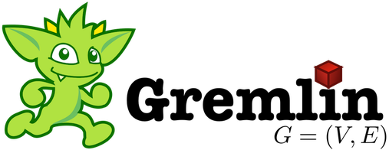
Which Azure Cosmos DB Data API?
Core (SQL) API
Gremlin

Slide 46
Which Azure Cosmos DB Data API?
Core (SQL) API
Cassandra

Slide 47
Migrating to NoSQL

Slide 48
Database Considerations
Data Model/API

Slide 49
Database Considerations
Data Model/API
Document Structure
Notes:
Document Structure:
Design documents for query patterns: Structure your documents based on the queries your application will execute. Embed related data within a single document to minimize the need for joins.

Slide 50
Database Considerations
Access Patterns
Even Data Distributions
Cardinality
Query Isolation
Write Patterns
Data Growth
Familiarity with Data
Data Relationship
Cost Considerations
Immutable Properties
Data Size
Trial and Error
Data Model/API
Document Structure
Partition Key
Notes:
Partition Key:
Choose a partition key carefully: The partition key determines how data is distributed across physical partitions. It's crucial to select a partition key that evenly distributes data and supports your most common queries.
Avoid frequent updates to the partition key: Frequent updates to the partition key can lead to inefficient partition migrations.
Access Patterns:
Analyze your application's common access patterns: Understand how your application will query and retrieve data. The partition key should align with frequently used query patterns to avoid cross-partition queries.
Even Data Distribution:
Choose a partition key that distributes data evenly: Uneven data distribution can lead to "hot" partitions that experience high traffic and performance bottlenecks. This can affect both read and write operations.
Cardinality:
Opt for a high-cardinality property: A property with a large number of distinct values can distribute data more evenly across partitions. This helps prevent data skew.
Query Isolation:
Aim for minimal cross-partition queries: Minimize the need for queries that span multiple partitions, as they can be less efficient.
Write Patterns:
Consider write patterns: If your application has write-intensive operations, choose a partition key that spreads write operations across partitions to prevent write bottlenecks.
Data Growth:
Account for future growth: Choose a partition key that accommodates future data growth and distribution.
Familiarity with Data:
Choose a property that makes sense to users: If the partition key corresponds to a property that users are familiar with, it can enhance the usability of your application.
Data Relationship:
Understand data relationships: If your data has inherent relationships, consider using properties that reflect these relationships as the partition key.
Cost Considerations:
Be mindful of RU costs: Each partition key has its own RU (Request Unit) requirements. Select a partition key that aligns with your budget and performance needs.
Immutable Properties:
Prefer immutable properties: Choosing an immutable property as the partition key reduces the need for frequent updates to the key, which can lead to partition migrations.
Data Size:
Consider data size: Smaller documents are generally better for performance. If your partition key is too large, it could impact performance.
Trial and Error:
Test and iterate: It might be necessary to try different partition keys, run performance tests, and iterate based on the results to find the best fit.

Slide 51
Database Considerations
Data Model/API
Document Structure
Partition Key
Indexing
Notes:
Indexing:
Choose appropriate indexes: Create indexes on the properties used in your queries to improve query performance.
Avoid excessive indexing: Unnecessary indexes can impact write performance and increase storage costs.

Slide 52
Database Considerations
Data Model/API
Document Structure
Partition Key
Indexing
Query Performance
Notes:
Query Performance:
Optimize queries: Use the Query Explorer or other query optimization tools provided by CosmosDB to fine-tune your queries.
Use the "Request Units" (RUs) wisely: Each query consumes a certain amount of RUs. Understand your application's RU requirements to manage costs and performance.
Be mindful of cross-partition queries: While CosmosDB is optimized for distributed queries, cross-partition queries can still impact performance. Minimize cross-partition queries if possible.

Slide 53
Database Considerations
Data Model/API
Document Structure
Partition Key
Indexing
Query Performance
Consistency Level
Notes:
Consistency Levels:
Choose consistency levels carefully: Different consistency levels impact read and write latencies differently. Choose a level that aligns with your application's requirements.

Slide 54
Database Considerations
Data Model/API
Document Structure
Partition Key
Indexing
Query Performance
Consistency Level
Time-to-Live (TTL)
Notes:
TTL (Time-to-Live):
Use Time-to-Live (TTL) effectively: TTL allows you to automatically delete expired documents. Use it for managing data retention and cleanup.
Versioning and Evolution:

Slide 55
Database Considerations
Data Model/API
Document Structure
Partition Key
Indexing
Query Performance
Consistency Level
Time-to-Live (TTL)
Data Migration
Notes:
Data Migration:
Plan for data migration: If migrating from an existing SQL database, plan how to map the data and queries to the CosmosDB SQL API.

Slide 56
Database Considerations
Data Model/API
Document Structure
Partition Key
Indexing
Query Performance
Consistency Level
Time-to-Live (TTL)
Data Migration
Versioning and Evolution
Notes:
Versioning and Evolution:
Plan for document versioning: Design your documents to accommodate future schema changes and evolution.

Slide 57
Document Database Structure
Cosmos DB Account
Database
Database
Container
Container
Container
Container
Item
Item
Item
Item
Item
Item
Item
Item

Slide 58
Data Model
CountryDivision
WorldRegion
Country
CurrencyCountry
CustomerAddress
ProductPrice
Currency
Customer
ProductTheme
Language
CustomerOrder
Theme
LanguageCulture
CustomerOrderItem
OrderStatus
Product
Content
ContentCopy
ProductAvailability
ContentType

Slide 59
Data Model
Metadata
Themes
Products
Customers
CountryDivision
WorldRegion
Country
Theme
Product
Customer
Country
CurrencyCountry
CountryDivision
CustomerOrder
CustomerAddress
ProductPrice
Currency
Currency
Customer
ProductTheme
Language
LanguageCulture
CustomerOrder
Theme
LanguageCulture
OrderStatus
ProductAvailability
OrderStatus
Product
Content
Content
ContentCopy
CustomerOrderItem
ContentCopy
WorldRegion
ProductAvailability
ContentType

Slide 60
Data Model
Metadata
Themes
Products
Customers
Country
Theme
Product
Customer
CountryDivision
CustomerOrder
Currency
LanguageCulture
OrderStatus
ProductAvailability
WorldRegion

Slide 61
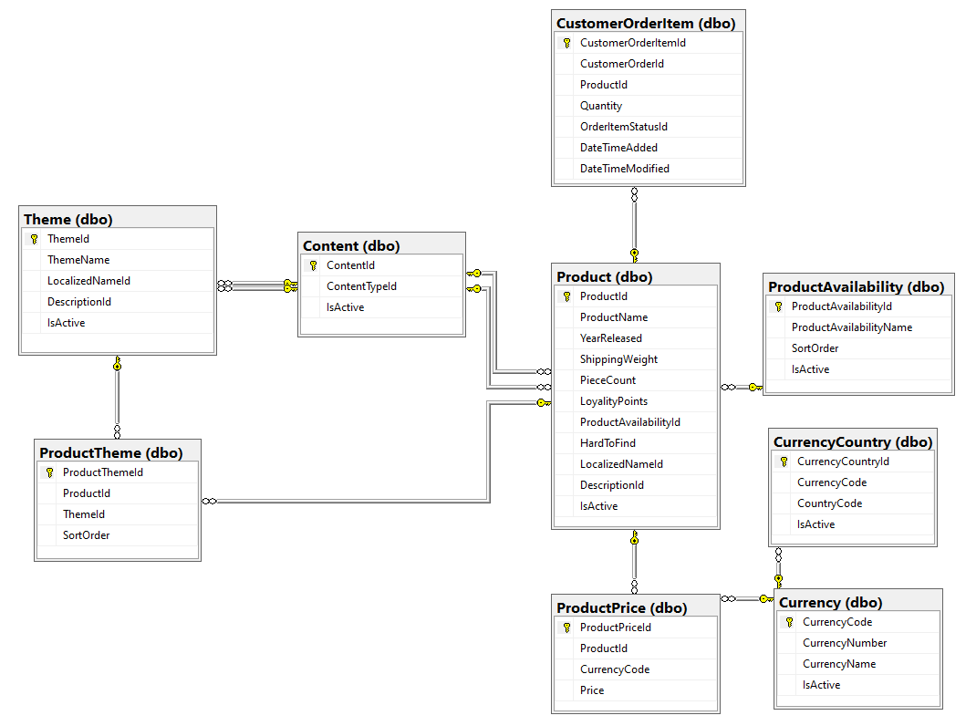
Data Model - Theme

Slide 62
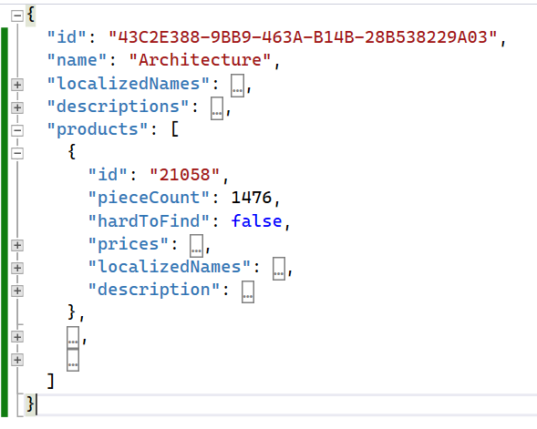
Data Model – Theme

Slide 63

Reference Types
Product Availability
Theme (Products)
Product

Slide 64
Code Examples

Slide 65
Best Tool(s) for the Job

Slide 66

Thank You
chadgreen@chadgreen.com
TaleLearnCode
ChadGreen.com
ChadGreen & TaleLearnCode
ChadwickEGreen

